Slide 1
IC HACK 2.0
TEAM NAME : TECHESPRESSO
TEAM LEADER NAME : SHRESHTA KUSHWAHA
DOMAIN : INNOVATION IN TRANSPORTATION
TITLE : Breakthroughs in Vehicle Safety and Connectivity

Slide 2
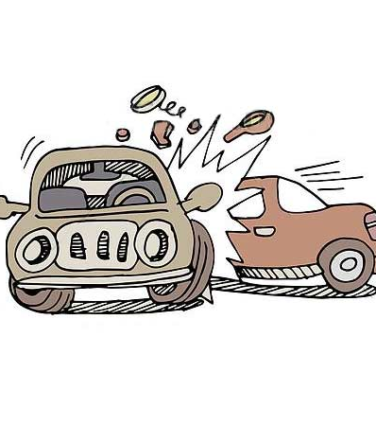
Problem Statement
This challenge empowers participants to reimagine the possibilities in vehicle safety and communication. We seek innovative solutions that harness cutting-edge technologies to redefine our experience and interaction with vehicles.

Slide 3

AREA OF FOCUS
Stay Sober Behind the Wheel: -
"Don't Drink and Drive: Arrive Alive!"

Slide 4
Proposed Solution:
Problem: Drink and driving
Solution: If the alcohol level exceeds a certain threshold,
The system triggers a WARNING.
An audio message informs the driver that 10 minutes are given to find a safe space for parking.
If alcohol levels are extremely high and the speed is high, the system initiates gradual deceleration and sets a speed limit (e.g., 30/40 mph

Slide 5
COMPONENTS USED:
Alcohol Sensor : Capable of measuring alcohol levels in the driver's breath.
Speed Sensor : To measure the speed of the vehicle.
Microcontroller :To process data and control vehicle functions.
Display Unit : A screen for displaying warnings and messages.

Slide 6
Team Member Details
TECHESPRESSO
Team Leader Name: SHRESHTA KUSHWAHA
Team Member 1 Name: AASHI

